Slide 1
An Improved Semantic Role Labeling System for Chinese
Lun-Wei Ku, Dora Chen, Shafqat Virk

Slide 2
Introduction
A semantic role labeling (SRL) system for Chinese by (You and Chen, 2004)
Sinica Treebank(Chen et al., 2003) for training and testing
Feature Set
Lexical featyres (e.g. head_word, head_word_pos,target_word, target_word_pos)
syntactic features (e.g. phrase_type,position)
The overall accuracy of the system was reported to be 92.71%.

Slide 3
Introduction
Though accuracy can be considered on the higher side, there was room for improvement, especially in two subtasks:
Data sparseness handling
Classification approach

Slide 4
Introduction
Data Sparseness handling
the old system used a back-off strategy to tackle this problem
It considerably improved the baseline performance, but still remained an issue

Slide 5
Introduction
Data Sparseness handling
Dependency of the system on non-generalized lexical features (e.g. head_word, target_word).
we use E-HowNet , a semantic knowledge-base for Chinese, to generalize two lexical features (i.e. head_word and target_word), and hence, to better address the data sparseness concern.

Slide 6
Introduction
Classification

Slide 7
Introduction
An Observation:
backing-off based on a constant threshold value did not allow to exploit the statistical knowledge in the best possible way.

Slide 8
Introduction
An Observation:
backing-off based on a constant threshold value did not allow to exploit the statistical knowledge in the best possible way.
The reason is that if enough examples, with a more constrained feature combination, have been seen in the training data, it did not allow to utilize the less constrained statistical information, which may suggest a more probable role

Slide 9
Introduction
A different strategy that is based on a combination of weighted simple probabilistic models.
Both more and less constrained probabilities are ranked by learned weights, and then the top ranked information is used for final decision making.
The probabilities are calculated
(i.e. Sinica treebank),
Optimal weights
using genetic algorithms.

Slide 10
Introduction
Comparison with other well established classification approaches (e.g. NaiveBayes, Decision Trees, Maximum Entropy, Linear Interpolation)
Our strategy outperformed all other systems including the previous system

Slide 11
Feature Set
In addition to the set of lexical and syntactic features, used by (You and Chen, 2004), we have used the following features:
pos_left_right_child: part of speech tags of the immediate left and right siblings of a test node.
passive: A sentence-level Boolean feature indicating weather the sentence, containing the test node, is passive or not.
all_pos: A set of part of speech tags of all nodes under a test node including the test node itself.
all_semType: A set of semantic types of all nodes of the tree, the test node is a child of.

Slide 12
Generalization of Lexical Statistics
As pointed out by (Gildea and Jurafsky, 2002), lexical statistics, though very useful for semantic role labeling, often becomes a source of data sparseness
We have generalized two lexical features:
head_word -> semanticType_head_word
target_word) -> semanticType_target_word

Slide 13
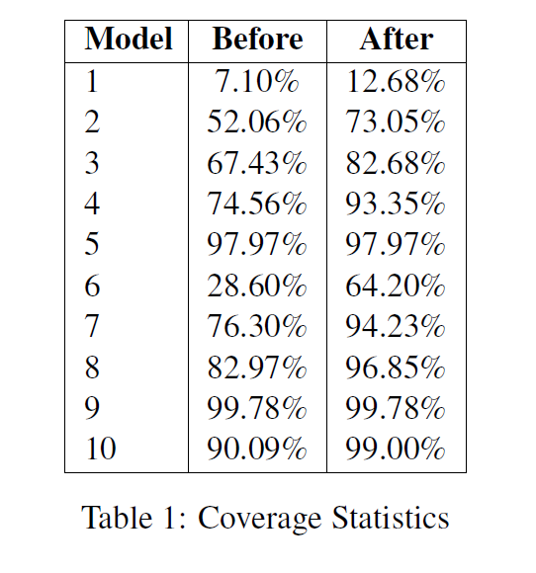
Generalization of Lexical Statistics

Slide 14

Probabilistic Models
Ten simple probabilistic models, each based on a particular feature combination
The probabilities for each model were estimated using the following simple formula.

Slide 15
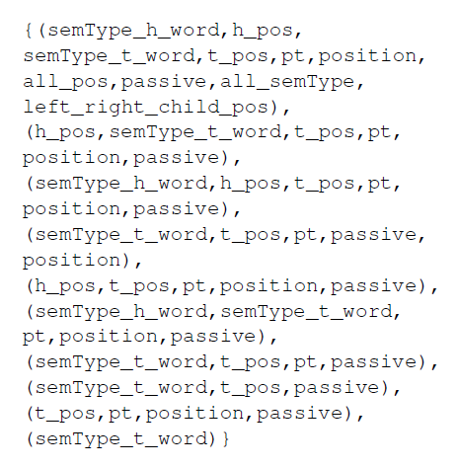
Feature Combinations

Slide 16
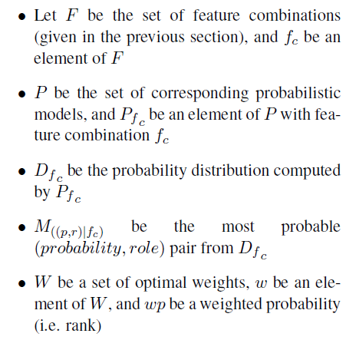
Classification Method
Notations:

Slide 17
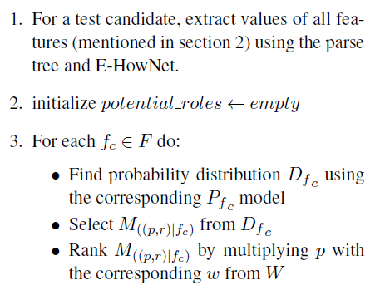
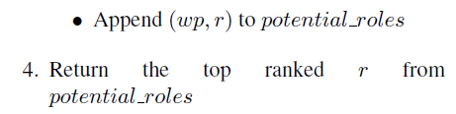
Classification Method
Algorithm:

Slide 18
An Example

